Slide 1
This is a hidden slide
Dear honorable teacher please follow the instructions that has given in the slide notes. (under the every slide). It would be helpful to take a successful class. Thanks a lot. I wish you good luck.

Slide 2
WELCOME
HOW ARE YOU ?
Notes:
Teacher can say it orally.

Slide 3
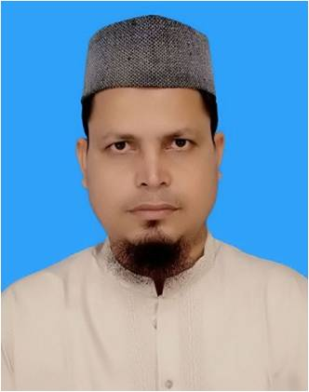
IDENTITY
SK.MD. HARUNAR RASHID.
Senior Teacher
Sonatola Model High School
Sonatola, Bogra.
Lesson
ENGLISH GRAMMAR.
Class : Six
Present Indefinite Tense
Notes:
Teacher can hide this slide.

Slide 4
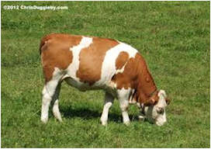
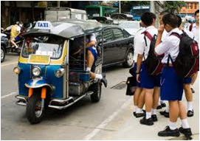
Mind set up : Can you speak in English about the following pictures ?
The cow lives on grass
The sun rises in the east.
They go to school everyday.
T. You are right. Thank a lot. Everybody claps for him
T. Can you say what kind of tense are those ?
S. Sir, They are present Indefinite tense.
Notes:
At first pictures will be shown. Teacher can try to elicit the answer from the students. Then he/she can give feedback by clicking.

Slide 5
Lesson Declaration
So today we shall discuss about
Present Indefinite Tense

Slide 6
LEARNING OUTCONES
After completing this lesson students will be able to
say how many kinds of Tense.
Write the structure of Present Indefinite Tense
Make correct sentence according to Present Indefinite Tense.
Re-write in Present Indefinite Tense.

Slide 7
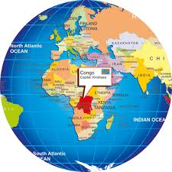
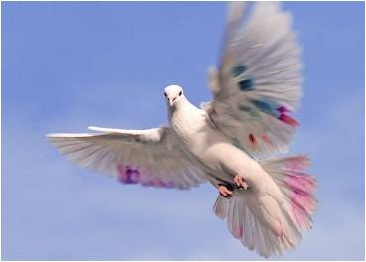
Present Indefinite Tense
Can anyone say the definition of Present Indefinite Tense.
Definition:
Present Indefinite Tense denotes an action in the present time of habitual event, universal truth, historical events and near future.
Notes:
At first pictures will be shown. Teacher can try to elicit the answer from the students. Then he/she can give feedback by clicking.

Slide 8
Present Indefinite Tense
Can anyone say the structure of Present Indefinite Tense
Aff : Sub + V1 + obj.
Neg : Sub + do not/ does not + V1 + obj.
Intre : Do/ Does + Sub + V1 + obj ?
If subject is third person singular number then s/es will be add with principle verb.
Notes:
Teacher can try to elicit the answer from the students. Then he/she can give feedback by clicking.

Slide 9
Present Indefinite Tense
If in the sentence there is everyday//always/regularly/
occasionally/usually/often/sometimes/ generally , the sentence will be Present Indefinite tense.
Example : Mother reads the Quran everyday.
Regularly I pay my tuition fees. etc.
Notes:
Teacher can try to elicit the answer from the students. Then he/she can give feedback by clicking.

Slide 10
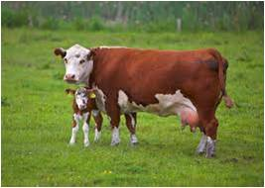
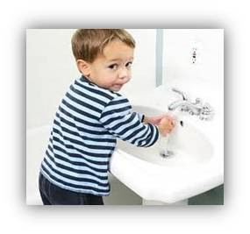
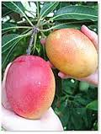
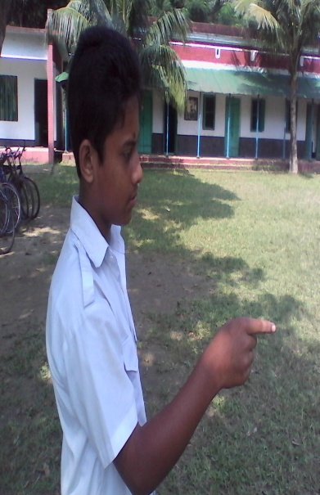
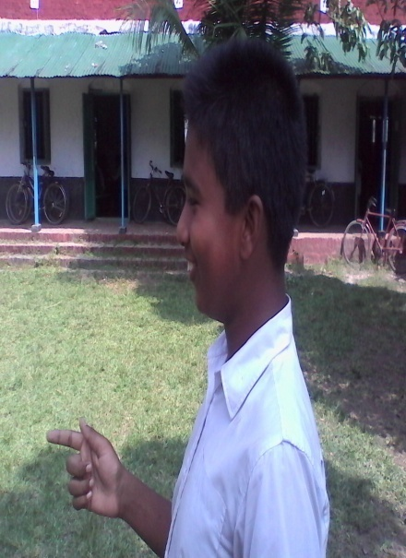
Pair work: Ask and answer - Follow the conversation
Yes, he does.
Do you like mango?
Yes, I do.
Mainly, what does the cow give us?
Mainly, The cow gives us milk?
Does he wash his hands before eating?
Now any two boys come to near my desk and make a dialogue using do/does or don`t/doesn`t.
Notes:
At first pictures will be shown. Teacher can try to elicit the answer from the students. Then he/she can give feedback by clicking.

Slide 11
INDEVETUAL WORK
Fill in the gaps with the right form of verbs that given in the box.
We (a) ---------- to school everyday but Rana (b) -------- not to go school everyday. He (c) ---------- football with his friends. (d) ---------- you go to school everyday ? What class does he (e) ----------- in ? Rahat (f) ---------- in Dhaka with his family. Do you (g) ------------ your school ? Sabina (h) ---------- a song. The sun (i) --------- in the east. A good teacher (j) ------------ his class interesting.
Play | Rise | Live | Do | Read
Sing | Catch | Make | Love | go
go
does
plays
Do
read
lives
love
sings
rises
makes
Notes:
At first pictures will be shown. Teacher can try to elicit the answer from the students. Then he/she can give feedback by clicking.

Slide 12
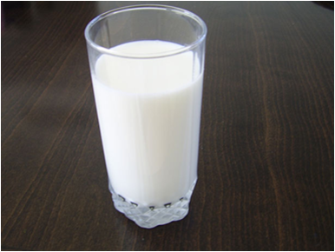
group works
Write three sentences (affirmative, negative and Interrogative) about the above picture according to the rules of Present Indefinite Tense.
Notes:
At first pictures will be shown. Teacher can try to elicit the answer from the students. Then he/she can give feedback by clicking.

Slide 13
HOME WORK
Write down five sentences that you and your sister do at your house. Using Present Indefinite Tense.
Notes:
Teacher can give some instructions to do the home work.

Slide 14
Acknowledgement
We would like to express our cordial gratitude to the Ministry of Education, Directorate of Secondary & Higher Education, NCTB, a2i
and
the panel of honorable editors ( Md. Jahangir Hasan, Associate Professor (English) TTC, Rangpur, Ranjit Poddar, Associate Professor (English) TTC, Dhaka, and Urmila Ahmed, Associate Professor (English) TTC, Dhaka, to enrich the contents.

Slide 15
THE END.
Notes:
Teacher can say another language.

